Slide 1
“Scrollable Cursor“

Slide 2
Scrollable cursor
For a scrollable cursor, the rows of the result table can be fetched many times. The cursor is moved through the result table based on the position option specified on the FETCH statement.
When the cursor is opened, it is positioned before the first row in the result table. When a FETCH is issued, the cursor is positioned to the row in the result table that is specified by the position option.
This row is then the current row. If host variables are specified (with the INTO clause on the FETCH statement), SQL moves the current row's contents into your program's host variables.

Slide 3
Scrollable cursor
Host variables cannot be specified for the BEFORE and AFTER position options.
This sequence is repeated each time a FETCH statement is issued. The cursor does not need to be closed when an end-of-data or beginning-of-data condition occurs.
The position options enable the program to continue fetching rows from the table.
The following scroll options are used to position the cursor when issuing a FETCH statement. These positions are relative to the current cursor location in the result table.

Slide 4
Scrolling options
NEXT | Positions the cursor on the next row. This is the default if no position is specified.
PRIOR | Positions the cursor on the previous row.
FIRST | Positions the cursor on the first row.
LAST | Positions the cursor on the last row.
BEFORE | Positions the cursor before the first row.
AFTER | Positions the cursor after the last row.
CURRENT | Does not change the cursor position.
RELATIVE n | Evaluates a host variable or integer n in relationship to the cursor's current position. For example, if n is -1, the cursor is positioned on the previous row of the result table. If n is +3, the cursor is positioned three rows after the current row.

Slide 5
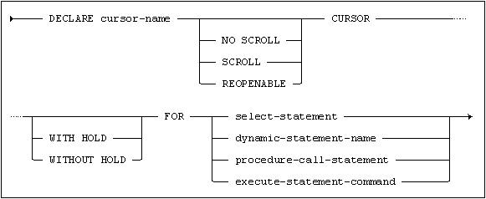
Declare Cursor
For a scrollable cursor, the end of the table can be determined by the following: FETCH AFTER FROM C1
Once the cursor is positioned at the end of the table, the program can use the PRIOR or RELATIVE scroll options to position and fetch data starting from the end of the table.

Slide 6
Scrollable cursor-open
The cursor is identified by cursor-name, and may be used in FETCH, DELETE CURRENT and UPDATE CURRENT statements.
The cursor must be activated with an OPEN statement before it can be used.
A cursor declared as REOPENABLE may be opened several times in succession, and previous cursor states are saved on a stack.

Slide 7
Scrollable cursor-with hold
A cursor declared as SCROLL will be a scrollable cursor. For a scrollable cursor, records can be fetched using an orientation specification.
A cursor declared WITH HOLD will be a holdable cursor. Open holdable cursors are not closed when a transaction is committed. A cursor will be non-holdable, if WITHOUT HOLD is explicitly specified.
WITHOUT HOLD and NO SCROLL are default cursor attributes and do not have to be specified
.

